Slide 1
Introduction to Processing Digital Sounds part 4
Barb Ericson
Georgia Institute of Technology
Sept 2005

Slide 2
Learning Goals
Make a sound as loud as possible
  Find the largest value in an array
Use System.out.println to check values
  To be sure the method is working
Review conditional execution
  Using if and else
Force all values to extremes
  Using maximum positive and negative values

Slide 3
Normalize Sounds
Make the whole sound as loud as possible
  How loud can it be?
    The max positive value is 32767.0
    The max negative value is -32768.0
  First we need to find the largest value (positive or negative) in the current sound
    Create a variable to hold the max
      And set it to the first value in the array
    And loop through the array and if the absolute value of the current value is greater
      Store that one instead

Slide 4
Find the Largest Value in an Array
Start with the first value in the array
  The one at index 0
    int max = valueArray[0];
Loop through the rest of the items in the array
  Compare the absolute value of the value at current index in the array to the absolute value of the largest
    If it is bigger store it in max
    for (int i = 1; i < valueArray.length; i++)
    {
    if (Math.abs(valueArray[i]) > Math.abs(max))
    max = valueArray[i];
    }

Slide 5
Find the Largest Value in an Array
int max = first element
max = valueArray[0] = 2000;
for (int i = 1; i < valueArray.length; i++)
{
if (Math.abs(valueArray[i]) >
Math.abs(max)
max = valueArray[i];
}
2000 | 1000 | -2344 | 100 | 3300

Slide 6
Find the Largest Value in an Array
What is the value of max each time through the loop?
i | value | max
 |  | 2000
1 | 1000 | 2000
2 | -2344 | -2344
3 | 100 | -2344
4 | 3300 | 3300
0 1 2 3 4
2000 | 1000 | -2344 | 100 | 3300

Slide 7
Normalize Sound - Continued
After we find the maximum value
  Determine the factor that we can multiply all values by
    And not go over the maximum allowed value
    double multiplier = 32767.0 / max;
  Call the method changeVolume with the multiplier
Test with
  String file =
  FileChooser.getMediaPath(“double preamble.wav”);
  Sound soundObj = new Sound(file);
  soundObj.explore();
  soundObj.normalize();
  soundObj.explore();

Slide 8
Normalize Method
public void normalize()
{
SoundSample[] sampleArray = this.getSamples();
SoundSample sample = sampleArray[0];
int value = 0;
int max = soundSample.getValue();
// loop comparing values
// to the current largest
for (int i = 1; i < sampleArray.length; i++)
{
sample = sampleArray[i];
value = sample.getValue();
if (Math.abs(value) >
Math.abs(max))
{
max = value;}
}
}
// calculate the multiplier
double multiplier = 32767.0 / max;
// change the volume
this.changeVolume(multiplier);
}

Slide 9
Testing Normalize
How do we know if it worked?
  We can play the sound but it may not sound all that different
  We can use the explorer to view the sound wave before and after we normalize the sound
    And see if the values changed
      Check more than one index
  We can use System.out.println to print out the largest value and the index of it
    We need to save the index of the maximum value
    And use the explorer to check the value at that index

Slide 10
Normalize Method – Revised
public void normalize()
{
SoundSample[] sampleArray = this.getSamples();
SoundSample sample = sampleArray[0];
int value = 0;
int max = soundSample.getValue();
int maxIndex = 0;
// loop comparing values
// to the current largest
for (int i = 1; i < sampleArray.length; i++)
{
sample = sampleArray[i];
value = sample.getValue();
if (Math.abs(value) >
Math.abs(max))
{
max = value;
maxIndex = i;
}
}
System.out.println(“largest “ +
max + “ at index “ +
maxIndex);
// calculate the multiplier
double multiplier = 32767.0 / max;
// change the volume
this.changeVolume(multiplier);
}
Notes:
You can use System.out.println(expression) to see what is happening in your method.

Slide 11
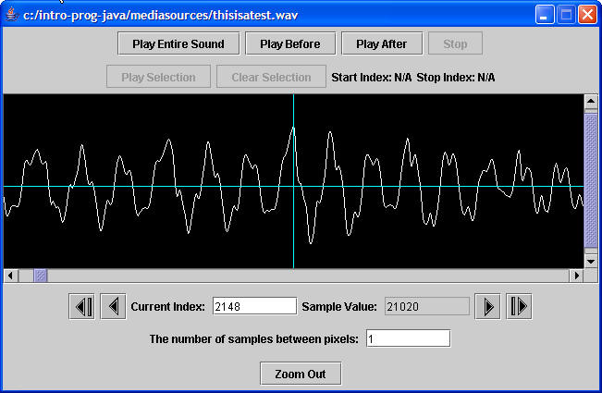
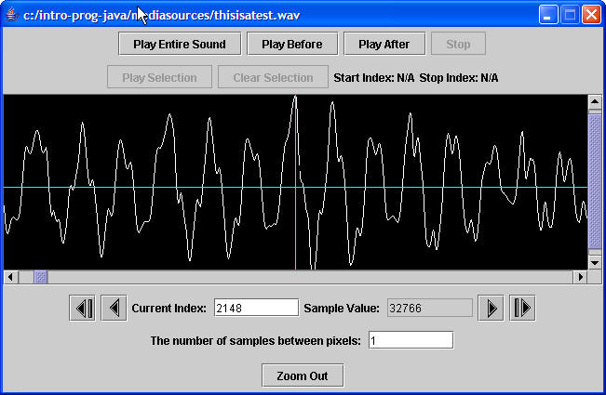
Testing Normalize
Before Normalize
After Normalize
Notes:
Using the sound file “thisisatest.wav”.

Slide 12
Force to Extremes
What if we want to make all values in a sound the maximum positive or negative value?
  If the value is positive make it 32,767
  If the value is negative make it -32,768
We need a way to execute code based on if a test is true
  We can use a conditional (if and else)

Slide 13
Conditionals
Allow you to only execute statements if an expression is true
  Or (optionally) only if it is false
If you clean your room
  You can go out
Else
  You must stay home
false
if (expression)
else
true
Statement or block
Statement or block
statement

Slide 14
Setting Values to Extremes Exercise
Write the method forceToExtremes()
  Change all positive values (including 0) to the max positive value 32767
  and change all the negative values to -32768.
  Using a conditional
    if and else
Test with:
  String file =
  FileChooser.getMediaPath(“preamble.wav“);
  Sound soundObj = new Sound(file);
  soundObj.explore();
  soundObj.forceToExtremes();
  soundObj.explore();

Slide 15
Summary
You can normalize a sound
  Make it as loud as possible
    Find the largest value in an array
      Set the largest to the first value in the array
      Loop from second value to end
      If the current value is greater than the largest save that value in largest
You can force all values to extremes
  If positive set to 32,767
  else set to -32,768

